Slide 1
BIA PROJECT & PRESENTATION Full PPT Deck
Group - 1
Ibrahim Salal Usman
Stephen Lee
Venkata Krishna Sridhar Akella
Anushree Chowdhary
Yash Bhardwaj
Harsh Mitesh Dalal

Slide 2
DATA SUMMARY
This is an operational dataset that describes the daily operations of a superstore in the US. The data specifically deals with fulfillment of orders. It includes information about the contents of the order and the location of the customer.
These records also include everything from the unique customer ID assigned to each purchase, dates of the order and shipment dates. Through this dataset, we can analyze the most profitable products along with the volume and nature of orders that are received at this store across regions, and be able to understand the store’s efficiency.

Slide 3
SUPER STORE
Source: Superstore Dataset | Kaggle
File Size: 2.19 MB
File Type: CSV
Number of Fields: 21
Number of Rows: ~10,000
Key Variables: OrderID (Primary Key), OrderDate, Ship Date, ShipMode, CustomerID, City, State, Region, Category, Sub-Category, ProductName, Sales, Quantity, Discount, Profit

Slide 4
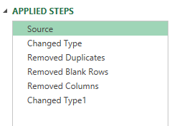
Data Transformation
Utilize Power Query
Matched types of column
IDs
Date and Time
Postal codes
Currency
Percents
Removed blanks and duplicates
Remove unnecessary columns

Slide 5
RESEARCH QUESTIONS
Questions:
Which category/sub-category has the highest/lowest total sales?
What is the average profit margin for all products and which products have the highest profit margins and products with lowest profit margin?
What is the relationship between Profit and Discount Offered across categories?
What are the shipping mode preferences of customers?
What is the trend of processing times (difference between Order Date and ship date) by Quarter and year?
Does the Pareto principle hold true in this business?

Slide 6
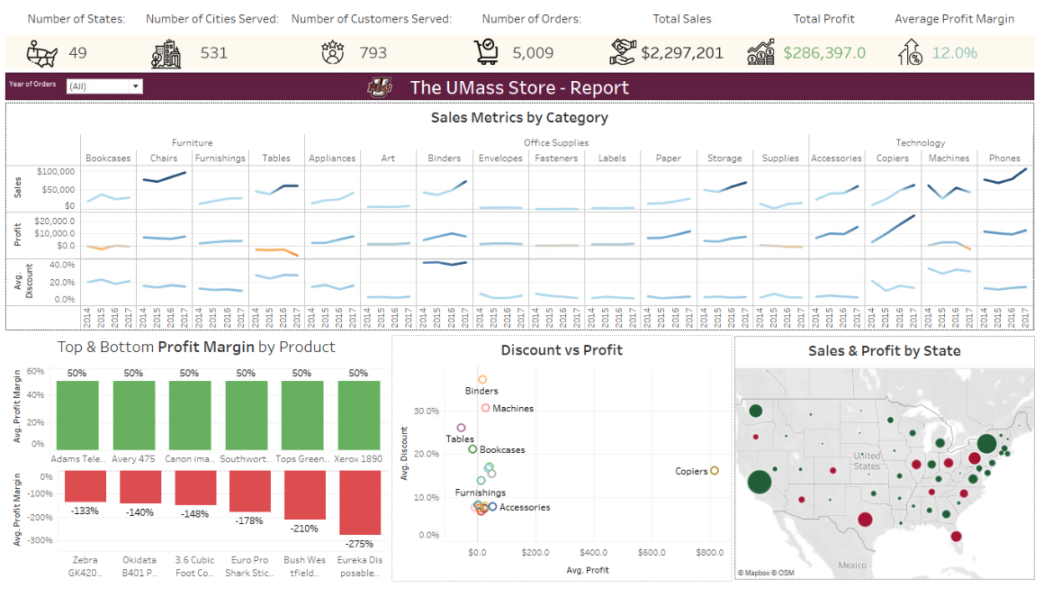
Dashboard 1 - Sales related Metrics

Slide 7
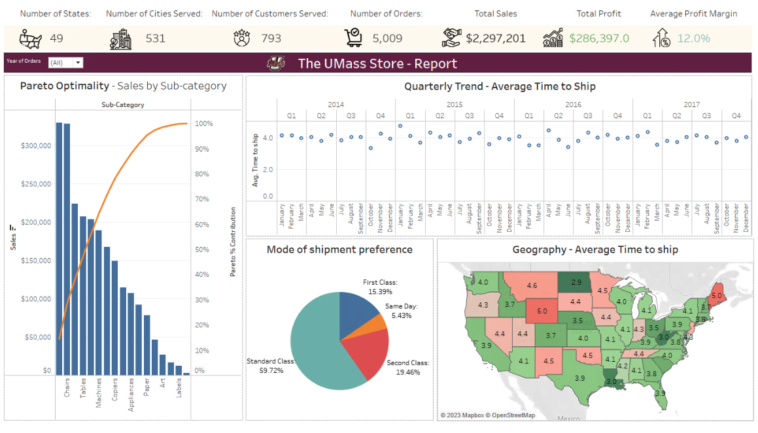
Dashboard 2 - Advanced Analytics & Shipping metrics

Slide 8
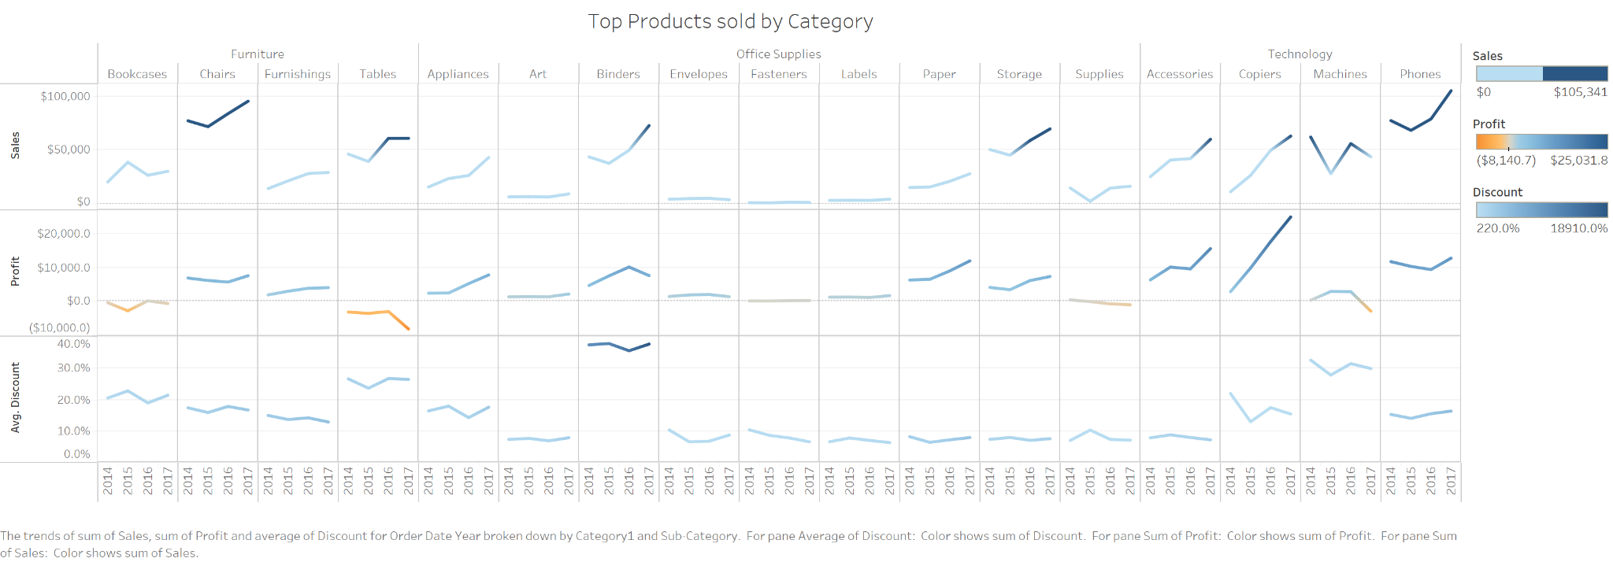
Which category/sub-category has the highest/lowest total sales?
This graph provides us with an overview of the sales and profitability performance of various product subcategories over the years. Bookcases and subcategory tables both display negative profits, as can be seen.
Chart type - Lines(Discrete) and we used colors to show high and low for sales, profit and discount.

Slide 9
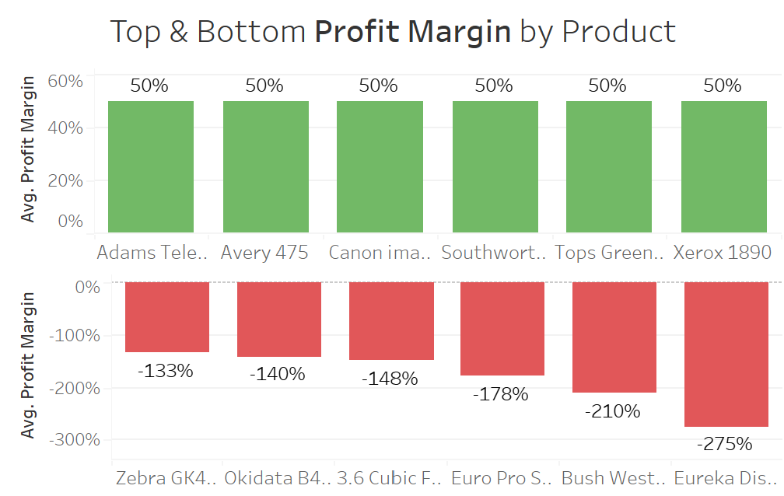

2. What is the average profit margin for all products and which products have the highest profit margins and products with lowest profit margin?
Chart Type: Bar charts with color coding for Profit Margin %
The Average Profit Margin 12 % is displayed in the visual banner display in Dashboard 1

Slide 10
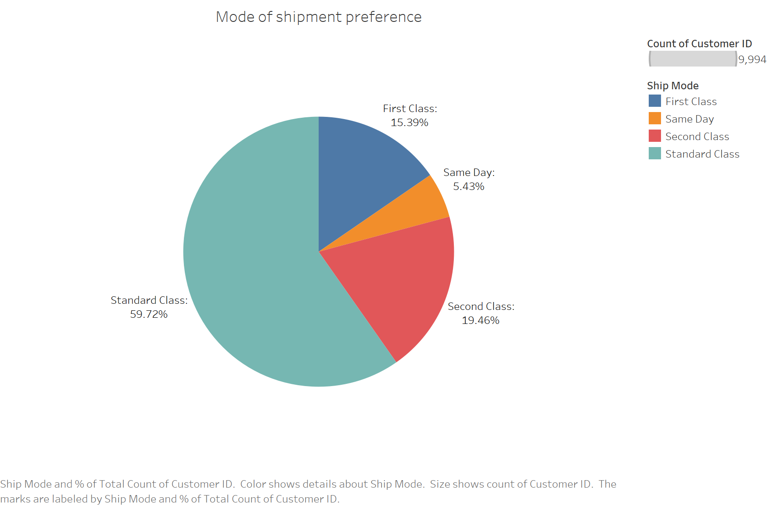
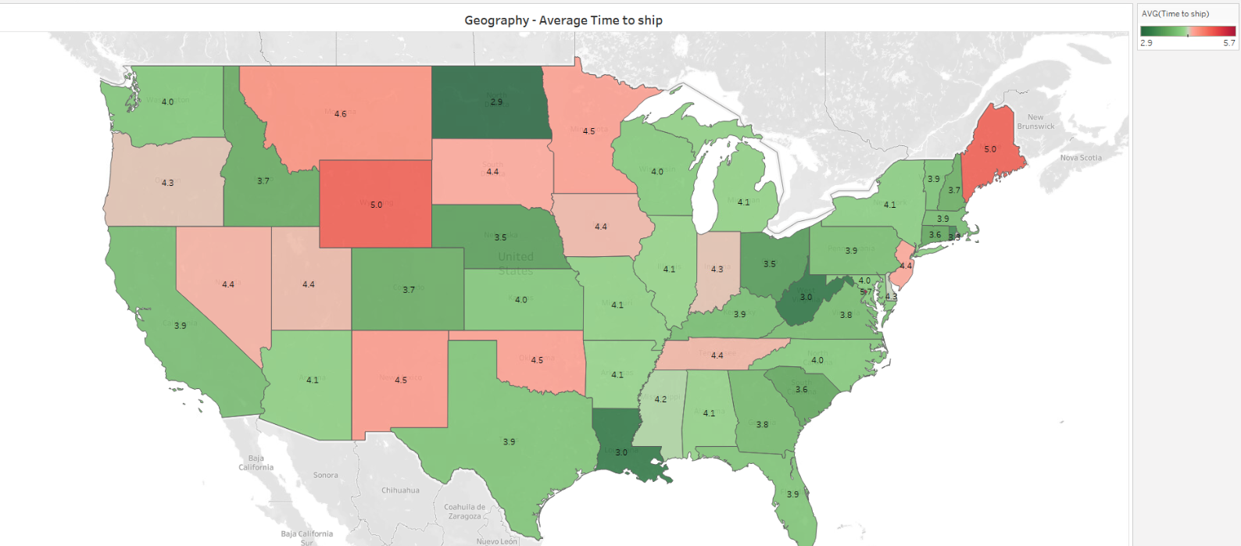
3. What are the shipping mode preferences of customers?
This chart lists the available shipment modes together with the preferred mode at the time of the purchase. It is evident that the most favored shipment mode is Standard class.
The heat map shows the geographical representation of the average time of shipping.
Chart type: Pie Chart & Heat Map

Slide 11
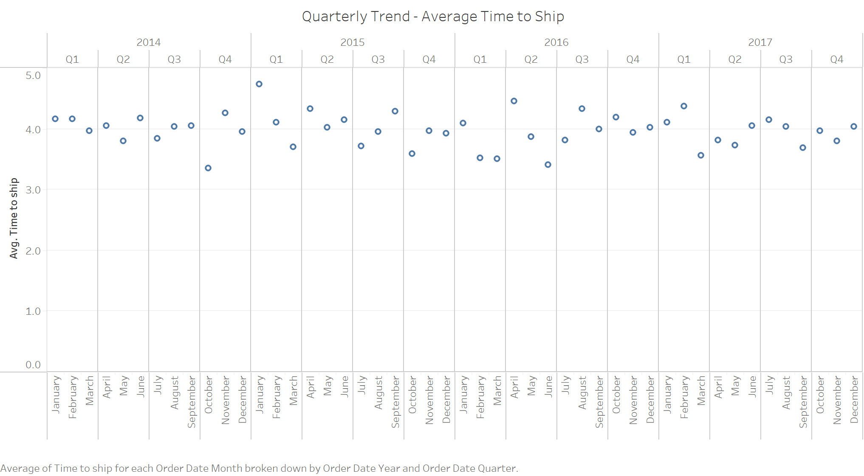
4. What is the trend of processing times (difference between Order Date and ship date) by Quarter and year?
This graph displays, by quarter and year, the average time it takes to ship an order for each month. It's evident that the delivery time hasn't changed much throughout the years. It seems that shipping times remain unchanged significantly despite new technologies being integrated into store operations.
Chart type: Line chart, but kept the points as Discrete, so that the highs and low points can be observed clearly

Slide 12
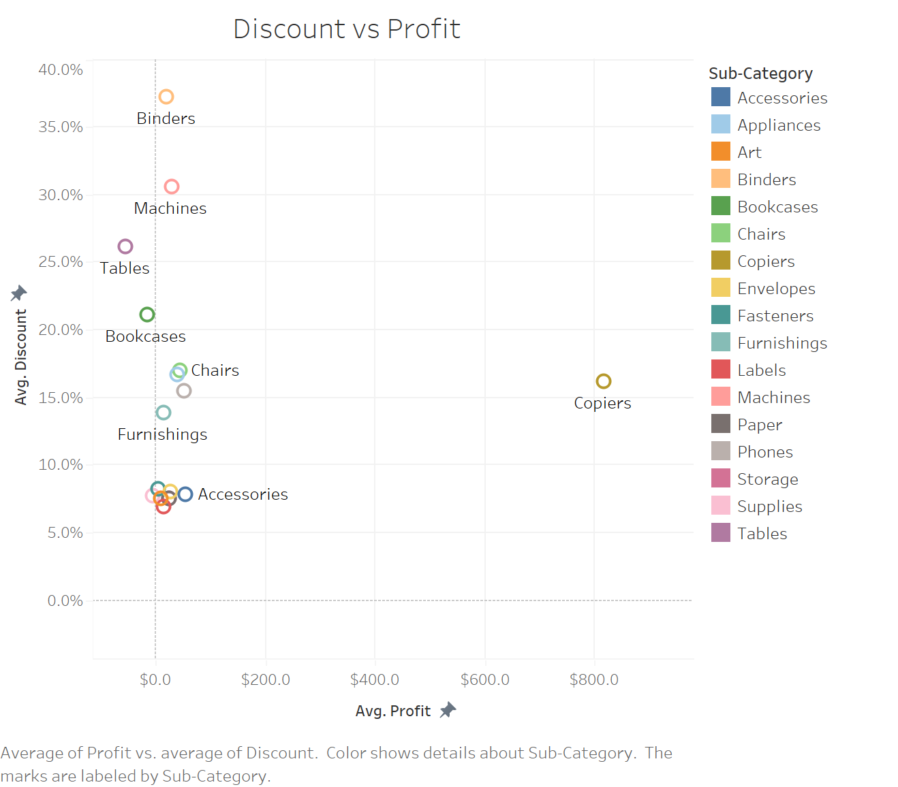
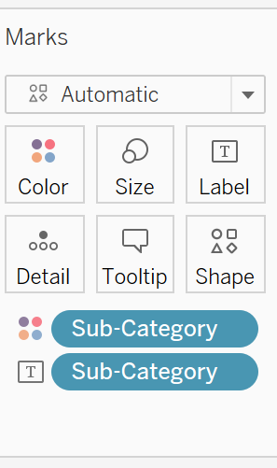
5. What is the relationship between Profit and Discount Offered across categories?
The link between profit and discount for different categories is displayed in this graph. Even though giving out discounts decreases profit margins but it isn't a formal relationship between Profits and Discounts.
Copiers is one of the outliers; despite the discounts, they have demonstrated profitability. Tables, on the other hand, have the lowest profits, and it is evident that they have one of the largest discounts.
Chart Type - Scatter Plot

Slide 13
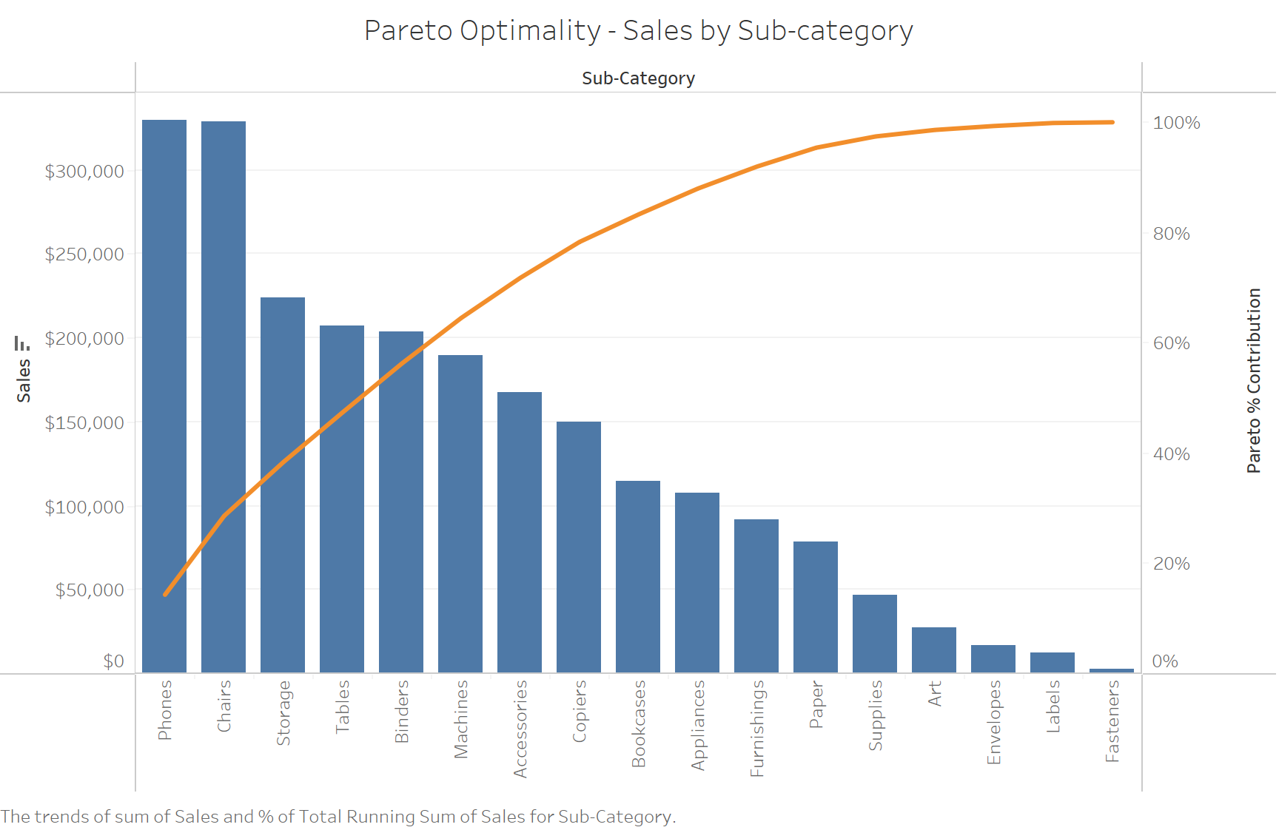
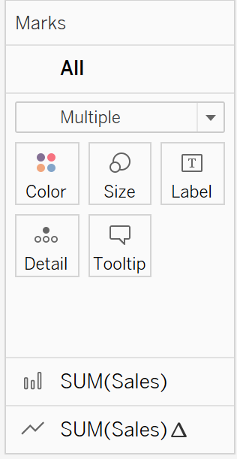
6. Does the Pareto principle hold true in this business?
The Pareto Principle or also known as 80/20 rule, specifies that 80% of consequences come from 20% of the causes, asserting an unequal relationship between inputs and outputs. This is a general rule of thumb observed in not only businesses but many other walks of life but here we can see that this does not hold true for the business.
This can hint towards to fragmented sale which would require higher resources and efforts to reach targets and hence resulting in poor Net margins.
Chart type: Dual Axis Line and Bar chart

Slide 14
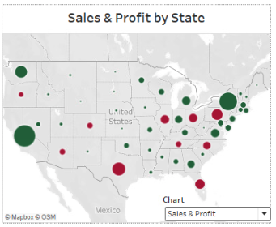
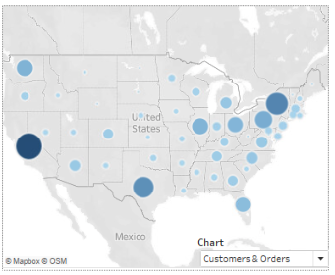
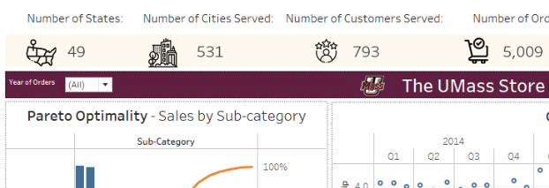
Extra Credit
Banners to answer many single word questions
Dual Chart and explored Advanced Analytics in the form of Pareto Principle
Chart switching through Parameters (3)
Filters for users (4)
(3) Changing the filter changes the chart type
(4)

